Slide 1
Tut 7 & Review
Jingyu Li

Slide 2

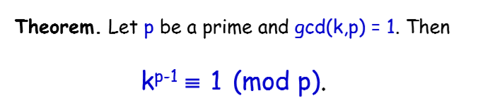

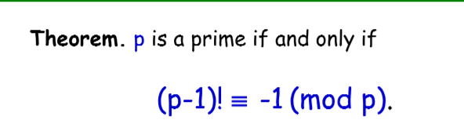
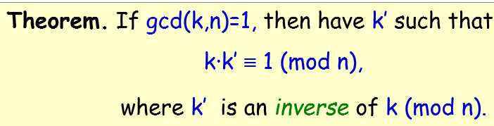

Slide 3
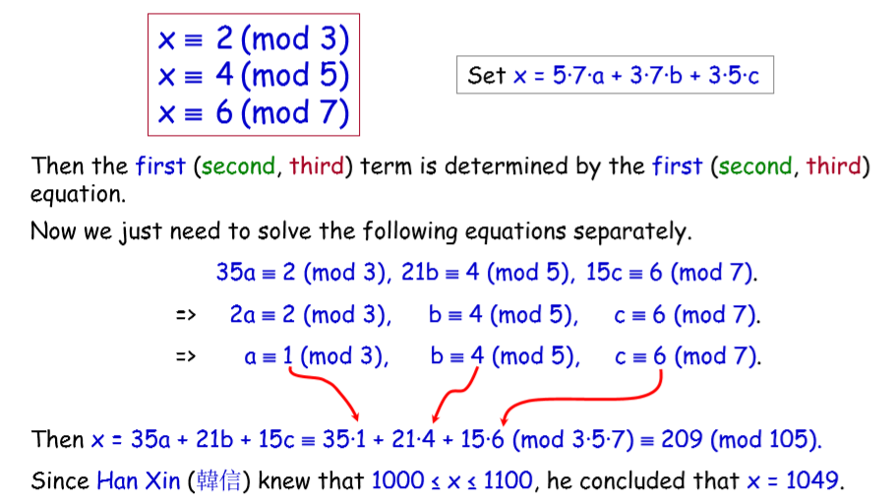

Slide 4
Question
Find the smallest positive three consecutive integers such that they are divisible by 4,9,25 respectively.

Slide 5
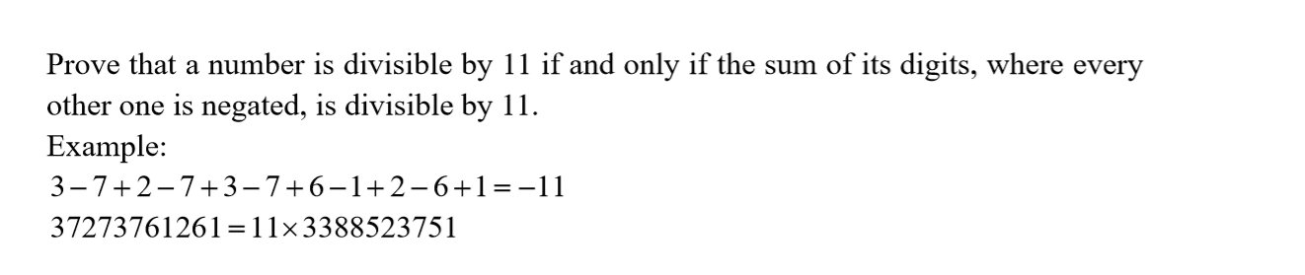

Slide 6


Question
Let a∈Z⁺, b∈Z⁺ be such that gcd(a,b) = 1. Prove that there exists n∈Z⁺ such that a^{n} ≡ 1 (mod b).

Slide 7
What we have learned…
1. Logic and Set
2. Proof I (basic, Invariant method, WOP)
3. Proof II (Mathematical induction)
4. Recursion
5. Greatest common divisors
6. Modular arithmetic (CRT)

Slide 8
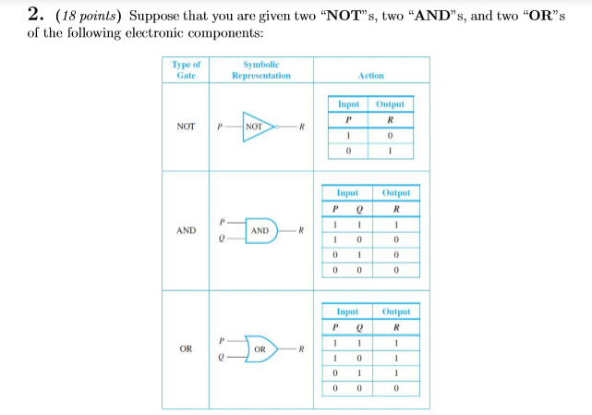
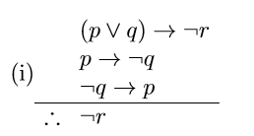
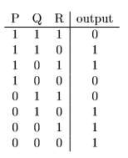
1. Logic and Set

Slide 9
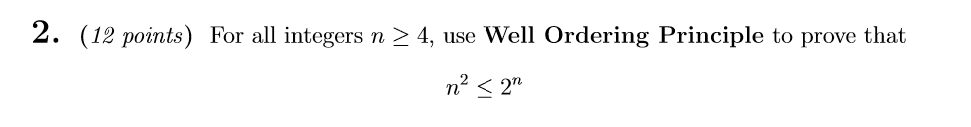
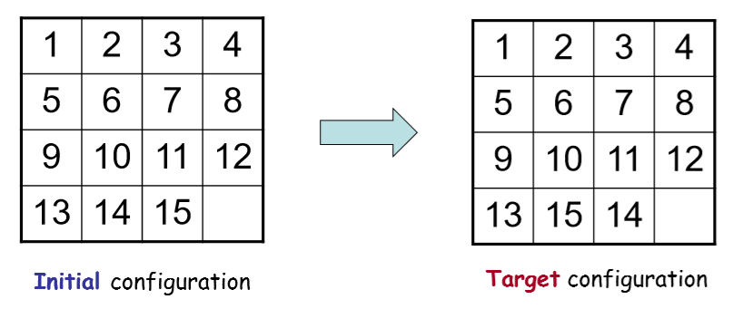
2. Proof I (basic, Invariant method, WOP)

Slide 10
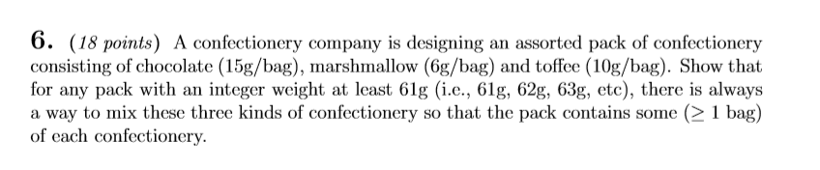
3. Proof II (Mathematical induction)

Slide 11
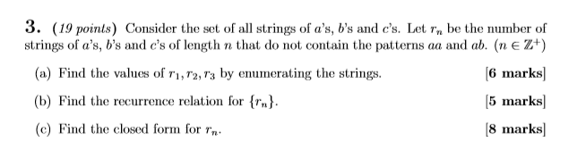
4. Recursion

Slide 12

5. Greatest common divisors

Slide 13
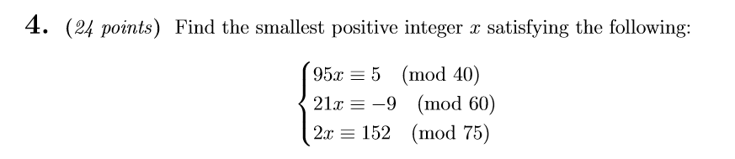
6. Modular arithmetic (CRT)

